Slide 1
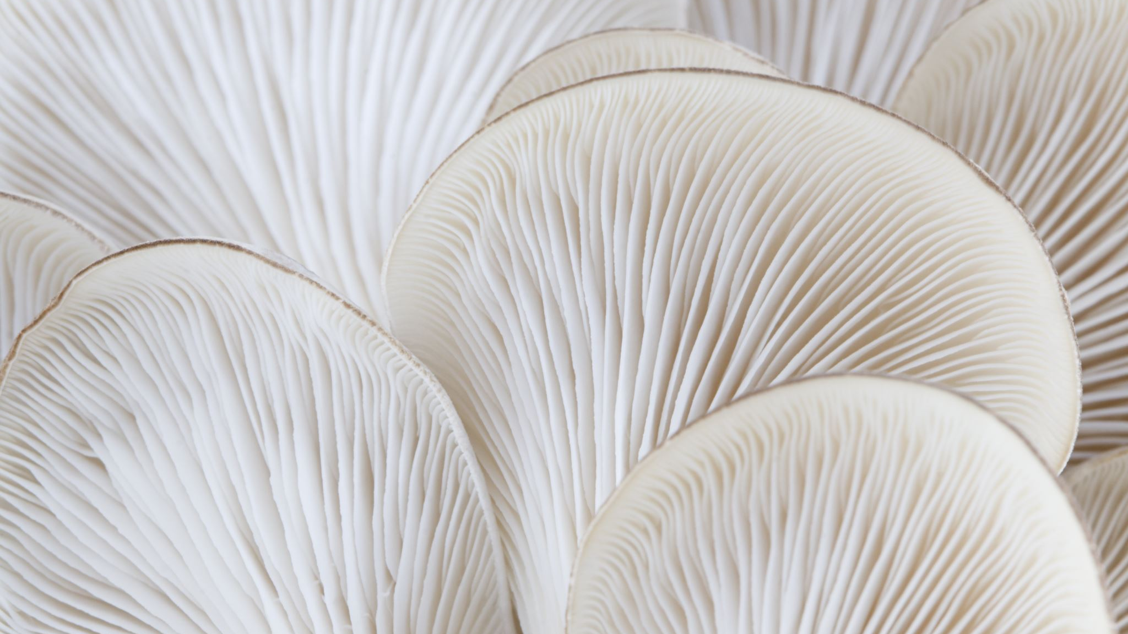
Slide 1: Title Mushroom Classification using Supervised ML

Slide 2

Objective: Classify mushrooms as edible or poisonous
Dataset: Sourced from Kaggle, describes 23 mushroom species
Target Variable: 'class' - Edible or Poisonous

Slide 3

Slide 3: Models Used
Supervised ML Models
Logistic Regression
Decision Tree
K Nearest Neighbor
Bagging Model
Random Forest
Naive Bayes
Support Vector Machine

Slide 4

Slide 4: Model Focus
Classification Task: Categorizing mushrooms
Features: Various characteristics of mushrooms
Approach: Train models on the dataset

Slide 5

Slide 5: Methodology
Data Preprocessing: Cleaning and transformation
Model Selection: Choose models based on task
Training & Validation: Using historical data
Evaluation: Comparing model performance

Slide 6

Slide 6: Model Performance
Metrics: Accuracy, precision, recall, F1-score
Comparison: How models perform on the task
Insights: Identify strengths and weaknesses

Slide 7

Slide 7: Interpretation & Application
Interpretability: Understandable decision rules
Application: Identify edible vs. poisonous mushrooms
Decision Support: Guide users in mushroom identification

Slide 8

Slide 8: Conclusion & Future Steps
Achievements: Built and evaluated multiple models
Next Steps: Feature engineering, hyperparameter tuning
Future: Improving accuracy and exploring ensembling

